Slide 1
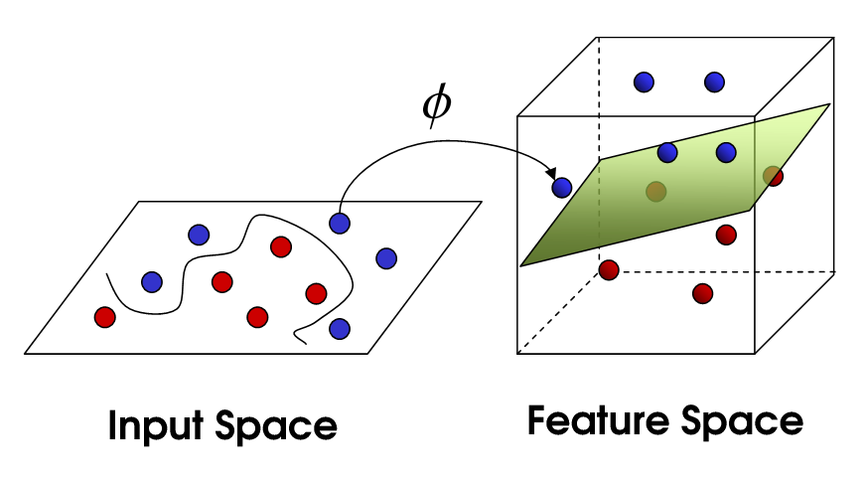
Support Vector Machine

Slide 2
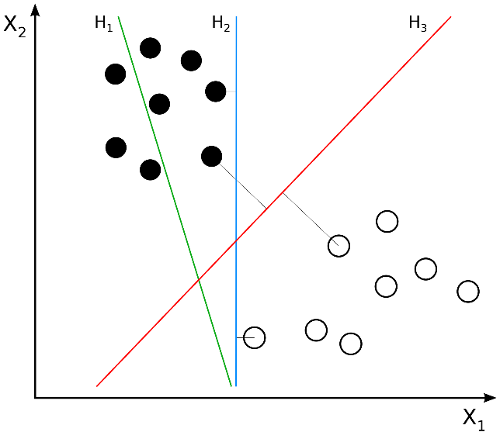
SVM
Support Vector Machine is arguablty the most important and interesting recent discovery in Machine Learning
SVMs have a clever way to prevent over-fitting
SVMs have a very clever way to use a huge number of features without requiring nearly as much computation as seems to be necessary.

Slide 3
Linear Classifiers
Binary classification can be viewed as the task of separating classes in feature space:
w^{T}x + b =
0
w^{T}x + b >
0
w^{T}x + b <
0
f(x)
= sign(w^{T}x
+
b)

Slide 4
Linear Classifier
w,b
x
f
y^{est}
b)
f(x,w,b)
= sign(w. x
-
denotes +1
denotes -1
How would you classify this data?
Any of these would be fine..
… but which is best

Slide 5
Linear Classifier
w,b
x
f
y^{est}
b)
denotes +1
denotes -1
f(x,w,b)
= sign(w. x
-
Margin of a Linear Classifier
Width that the boundary could be increased by before hitting a data point.

Slide 6
Maximum Margin
w,b
x
f
y^{est}
b)
denotes +1
denotes -1
f(x,w,b)
= sign(w. x
-
Support Vectors
are those data points that the margin pushes up against
according

Slide 7
denotes +1
denotes -1
Support Vectors
are those data points that the margin pushes up against
according

Slide 8
Reference

